Slide 1
TASK 3
Nabawagga Ritah

Slide 2
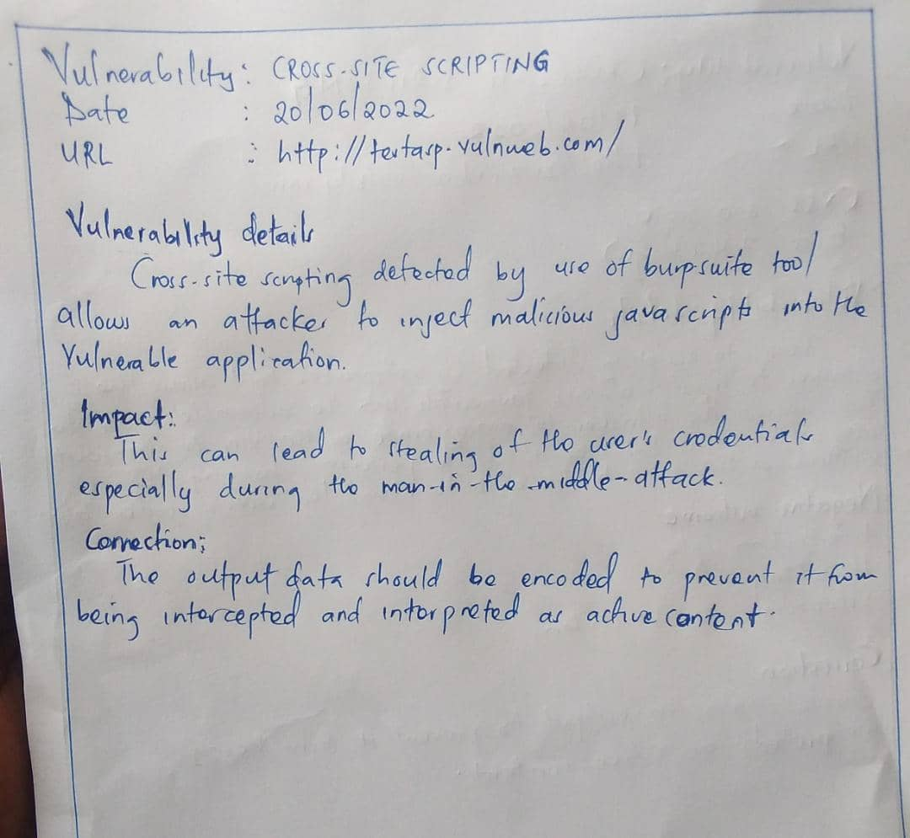
Report

Slide 3
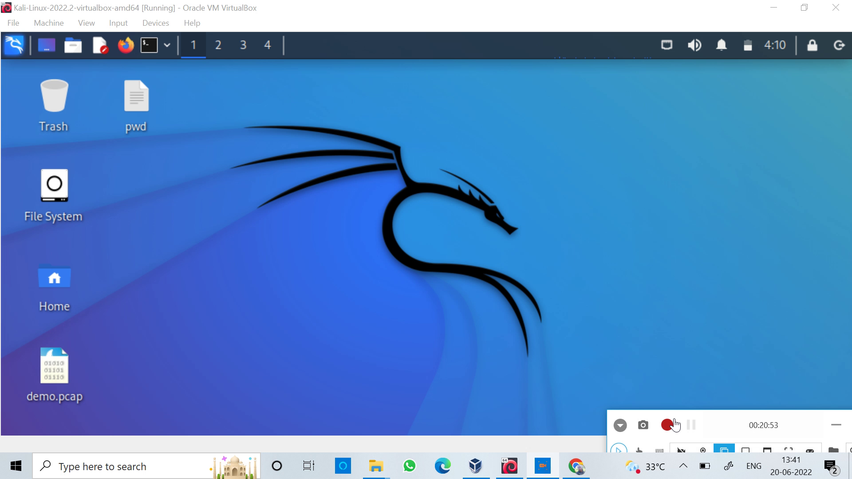
POC video

Slide 4
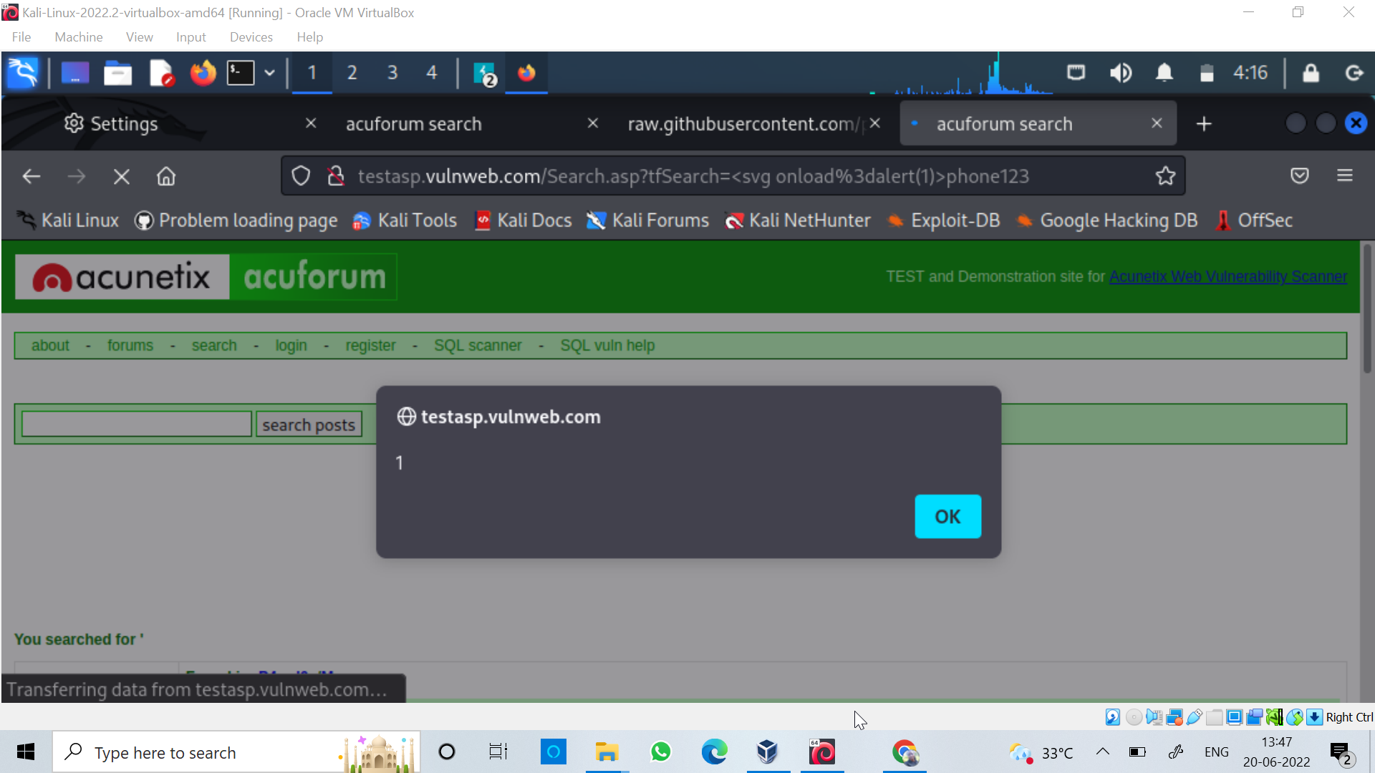
Screenshot of response

